Slide 1

INSTITUTE: UIE (AIT-CSE)
Computer Networks CST- 335
Lecture - 13 and 14
Load Shedding and Jitter Control , Leaky Bucket Algorithm and Token Bucket Algorithm
By : Dr.Monica Luthra(E9836)
DISCOVER . LEARN . EMPOWER

Slide 2

Course Objectives
CO Number | Title | Level
CO1 | To bring together several keys to Computer Network Design and Architecture. | Remember
CO2 | To recognize the key concepts of Internetworking. | Understand
CO3 | To prepare a sample Network via Simulation. | Understand

Slide 3
Course Objectives
CO Number | Title
CO1 | Describe the important networking concepts
CO2 | Understand concept of network reference models and protocols
CO3 | Apply the concepts of routing algorithms on various networks
CO4 | Identify mechanism to handle traffic and control on congestion
CO5 | Identify and understand connection establishment techniques and features

Slide 4
Table of Contents
Leaky Bucket
Token Bucket
Jitter Control
Load Shedding

Slide 5
Traffic Shaping
It is about regulating average rate of data flow.
It is a method of congestion control by providing shape to data flow before entering the packet into the network.
At connection set-up time, the sender and carrier negotiate a traffic pattern (shape)
There are two types of Traffic shaping algorithm :-
1. Leaky Bucket Algorithm.
2. Token Bucket Algorithm.

Slide 6
Leaky bucket Algorithm
The Leaky Bucket Algorithm used to control rate in a network.
It is implemented as a single-server queue with constant service time.
If the bucket (buffer) overflows then packets are discarded.
In this algorithm the input rate can vary but the output rate remains constant.
This algorithm saves busty traffic into fixed rate traffic by averaging the data rate.

Slide 7
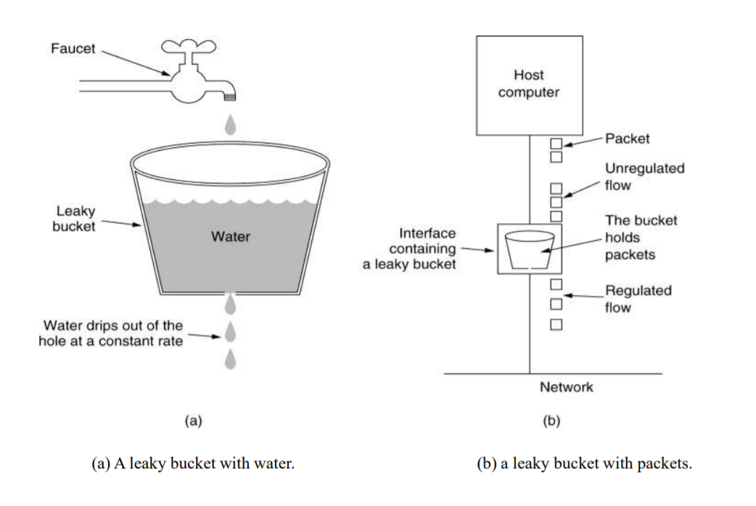
Leaky bucket Algorithm
Image Source :https://www.geeksforgeeks.org/leaky-bucket-algorithm/

Slide 8
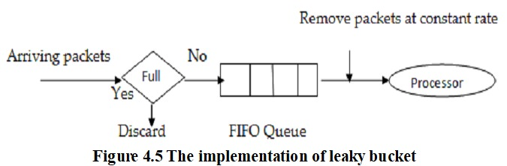
Leaky Bucket algorithm

Slide 9
Leaky Bucket Algorithm
Algorithm:
Step - 1 : Initialize the counter to ‘n’ at every tick of clock.
Step - 2 : If n is greater than the size of packet in the front of queue send the packet into the network and decrement the counter by size of packet. Repeat the step until n is less than the size of packet.
Step - 3 : Reset the counter and go to Step - 1.

Slide 10
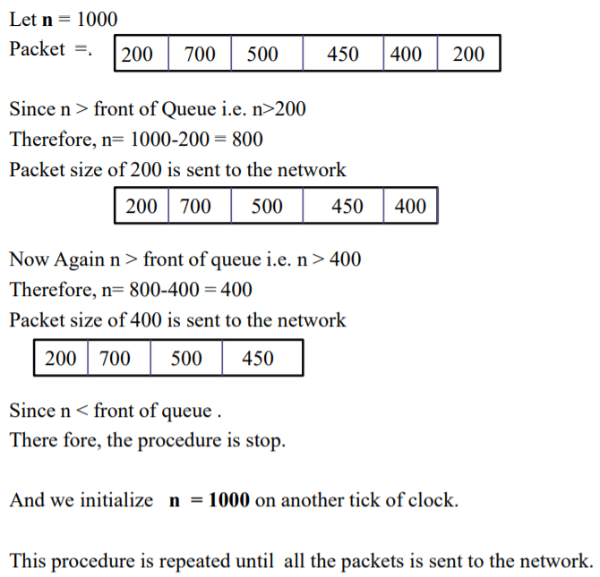
Example- leaky bucket Algorithm
Image Source :https://www.geeksforgeeks.org/leaky-bucket-algorithm/

Slide 11
Example- leaky bucket algorithm
Example: Consider a frame relay network having a capacity of 1Mb and data is input at the rate of 25mbps.Calculate:
1. What is the time needed to fill the bucket.
2. If the output rate is 2 mbps , the time needed to empty the bucket.
Ans. Here , C is Capacity of bucket = 1mb Data input rate = 25 mbps output rate = 2mbps.
T = C/input rate = 1/25 =1000/25= 40 msec
1T=1000MBPS
2. T = C/output rate = ½ = 500 msec
1000/2=500

Slide 12
Token Bucket Algorithm
The Token Bucket Algorithm compare to Leaky Bucket Algorithm allow the output rate vary depending on the size of burst.
In this algorithm the buckets holds token to transmit a packet, the host must capture and destroy one token.
Tokens are generated by a clock at the rate of one token every t sec.
Idle hosts can capture and save up tokens (up to the max. size of the bucket) in order to send larger bursts later.

Slide 13
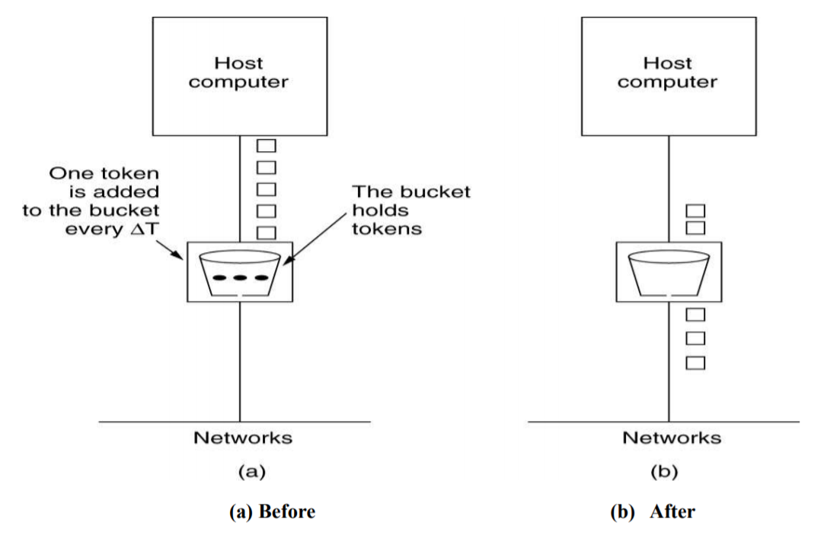
Token Bucket Algorithm
Image Source :https://www.geeksforgeeks.org/leaky-bucket-algorithm/

Slide 14
Token Bucket Algorithm
Algorithm:
Step - 1 : A token is added at every ∆t time.
Step - 2 : The bucket can hold at most b-tokens. If a token arrive when bucket is full it is discarded.
Step - 3 : When a packet of m bytes arrived m tokens are removed from the bucket and the packet is sent to the network.
Step – 4 : If less than n tokens are available no tokens are removed from the buckets and the packet is considered to be non conformant. The non conformant packet may be enqueued for subsequent transmission when sufficient token have been accumulated in the bucket. If C is the maximum capacity of bucket and ρ is the arrival rate and M is the maximum output rate then Burst Length S can be calculated as:
C + ρS = MS

Slide 15
Example –Token bucket Algorithm
Example: Consider a frame relay network having a capacity of 1Mb of data is arriving at the rate of 25mbps for 40msec.The Token arrival rate is 2mbps and the capacity of bucket is 500 kb with maximum output rate 25mbps.Calculate : C + ρS = MS
1. The Burst Length.
2. Total output time.
Ans. Here , C is Capacity of bucket = 500kb M= 25 mbps ρ = 2mbps.
S= 500/((25-2)*1000) =500/(23)= 21.73msec ~= 22msec
2 For 22msec the output rate is 25msec after that the output rate becomes 2mbps i.e. token arrival rate. Therefore, for another 500 kb the time taken will be. 500/(2000) = 250 msec (T = C/output rate)
Therefore, total output time = 22 +250 = 272 msec.

Slide 16
Jitter
1) It is variation in the time of delivery of packets at the receiver side.
2) There is uneven delay in the delivery of packets.
3) This uneven delay effects audio and video delivery, if packets will arrival uneven will lead to poor quality of the audio and video.
4) For example:- some packets arrive at rate of 3 ms and some 4 ms .This situation is known as jitter.
Jitter in IP networks is the variation in the latency on a packet flow between two systems, when some packets take longer to travel from one system to the other. Jitter results from network congestion, timing drift and route changes.

Slide 17
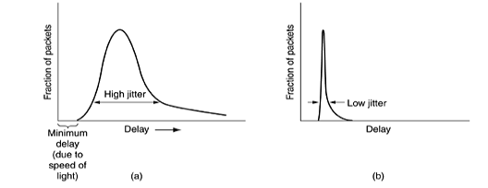
Jitter Control
The jitter can be bounded by computing the expected transit time for each hop along the path. When a packet arrives at a router, the router checks to see how much the packet is behind or ahead of its schedule. This information is stored in the packet and updated at each hop. If the packet is ahead of schedule, it is held just long enough to get it back on schedule. If it is behind schedule, the router tries to get it out the door quickly.
In fact, the algorithm for determining which of several packets competing for an output line should go next can always choose the packet furthest behind in its schedule.
In this way, packets that are ahead of schedule get slowed down and packets that are behind schedule get speeded up, in both cases reducing the amount of jitter.

Slide 18
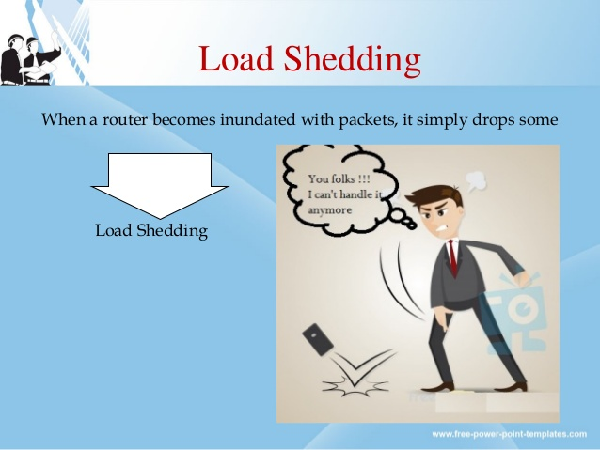
Load Shedding
Load shedding is a technique to remove excess load from the system in order to keep query processing up with the input arrival rates. As a result of load shedding, the system delivers approximate query answers with reduced latency.

Slide 19
Admission control, choke packets, fair queuing are the techniques suitable for light congestion.
But if these techniques cannot make the congestion to disappear, then the load shedding technique is to be used.
The principle of load shedding states that when the routers are being inaundated by the packets away.
A router which is flooding with packets due to congestion can drop any packets at random. The policy for dropping a packet depends on the type of packet. So the policy for file transfer called wine (old is better than new) and that for the multimedia is called milk (new is better than old). To implement such an intelligent discard policy, co-operation from the sender is essential. The applications should mark their packets are to be discarded the routers can first drop packets from the lowest class

Slide 20

Key Points
Traffic Shaping
Jitter Control
Load Shedding
Leaky Bucket Concept
Leaky Bucket Algorithm
Token Bucket Algorihm

Slide 21
FAQ
Explain Token Bucket Algorithm with example.
What is Traffic Shaping?
Write down 5 difference between Token Bucket and Leaky Bucket?
What is jitter control?
A leaky bucket is at the host network interface. The data rate on the network is 2MByte/s and the data rate on the link from the host to the bucket is 2.5Mbyte/s.
Computer A has 19.5MB to send on a network and transmits the data in a burst @ 6 Mbps. The maximum transmission rate across routers in the network is 4 Mbps. If Computer A's transmission is shaped using a leaky bucket, how much capacity must the queue in the bucket hold not to discard any data? (Show your work)

Slide 22
References
https://en.wikipedia.org/wiki/Leaky_bucket
https://www.geeksforgeeks.org/leaky-bucket-algorithm/
https://en.wikipedia.org/wiki/Token_bucket
https://www.ques10.com/p/31441/what-is-traffic-shaping-explain-leaky-bucket-algor/

Slide 23
THANK YOU
For queries
Email: monica.e9836@cumail.in

